Slide 1
Chapter 4
Continuous Distribution

Slide 2
Continuous Random Variables
Definition: A random variable is continuous if it can assume any real numbers and some interval (or intervals) of real numbers and the probability that it assume any specific value is 0 (zero).

Slide 3
CONTINUOUS DENSITY (Probability density function )
Definition: Let X be a continuous random variable. A function f(x) is called continuous density (probability density function i.e. pdf ) iff

Slide 4
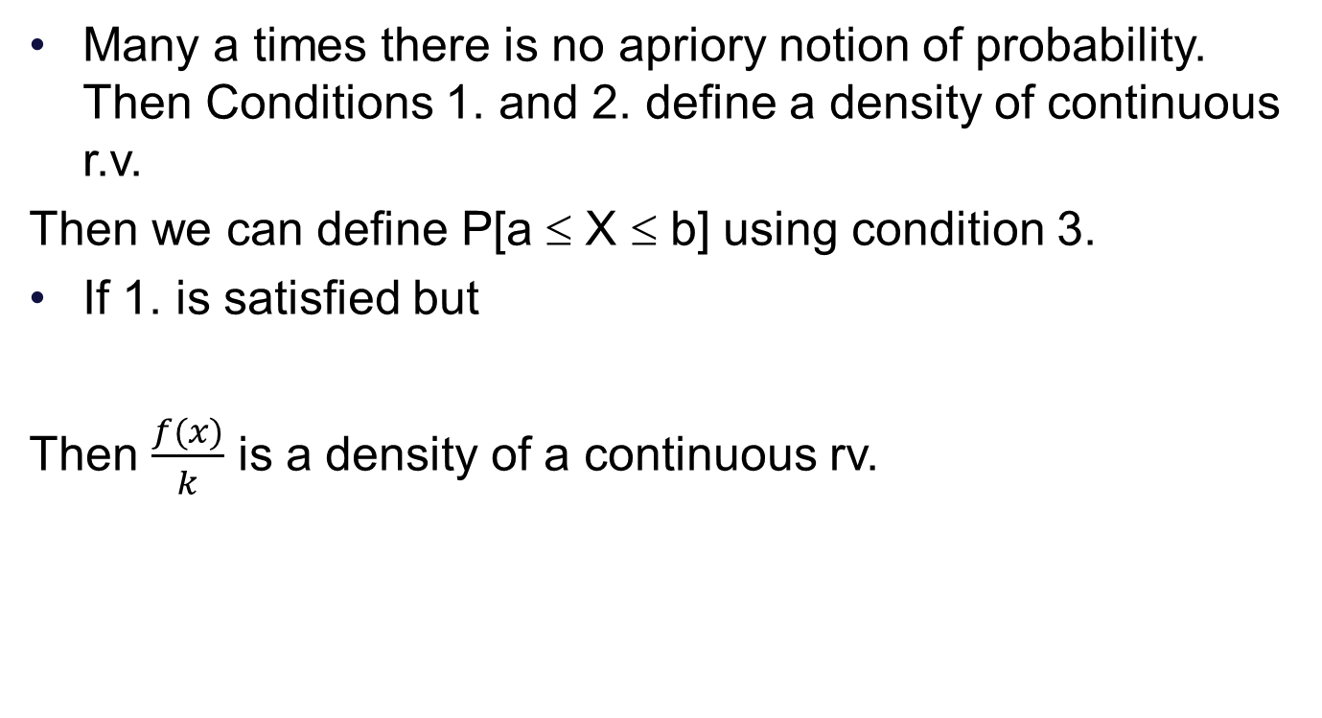
Note :

Slide 5
Probability for Interval
1.P[X = a] =0.
2. P[X = b] =0.
3. P[a ≤ X ≤ b] = P[ a ≤ X < b]
= P[a < X ≤ b] = P[a < X < b]
4. P[a ≤ X ≤ b] =
where a and b are real numbers. Area under the curve of f between x = a to x = b. TOTAL AREA IS ONE.

Slide 6
CUMULATIVE DISTRIBUTION FUNCTION
Let X be the continuous r.v. with density f(x). The cumulative distribution function (cdf) for X, denoted by F(X) , is defined by
F(X) = P ( X ≤ x ) , all x
=

Slide 7
PROBABILITY by using cdf F(x)
P(a ≤ X ≤ b) = F(b) – F(a).
FIND f(x) from F: f(x) = dF(x)/dx = F′(x) for all x.
Note:
If X is a Continuous random variable, then F(x) is also a continuous function for all x.
The F(x) is nondecreasing function.

Slide 8
Note : F is cdf of continuous rv if and only if 1., 2, 3.
and 4. hold.

Slide 9
EXERCISE 4.1, 9 PAGE 140
Consider the density of X
f (x ) = x / 6 ; 2 ≤ x ≤ 4 ,
= 0 ; e.w.
(a) Find the cumulative distribution function.
(b) Use cdf F, find P[2.5≤X≤ 3], P[1 ≤X≤3.5].

Slide 10
cumulative density function

Slide 11
Use cdf F, find P[2.5≤X≤ 3], P[1≤X≤3.5].

Slide 12
Example
The Cumulative distribution function (c.d.f.) of a continuous random variable X is
Determine α and β. Hence find the probability density function (p.d.f.).

Slide 13
EXERCISE 4.1.14, PAGE 141
In parts (a) and (b) proposed cumulative distribution functions are given. In each case, find the density that would be associated with each, and decide whether it really does define a valid continuous density. If it does not, explain what property fails.
(a) Consider the function F defined by
F(x) = 0 ; x < -1,
= x + 1 ; -1 ≤ x ≤ 0,
= 1 ; x > 0.

Slide 14
Clearly f(x)≥ 0 for all x. Also F is cdf as
Notes:
14

Slide 15
…. continue
4.1.14 (b)
Consider the function defined by
F(x) = 0 ; x ≤ 0 ,
= x² ; 0 < x ≤ 0.5 ,
= x/2 ; 0.5 < x ≤ 1 ,
= 1 ; x > 1 .

Slide 16
(5) (Continuous uniform distribution) A random variable X is said to be uniformly distributed over an interval (a, c) if its density is given by
Show that this is a density for a continuous random variable.
Sol:

Slide 17
Secondly,
(b) Sketch the graph of the uniform density.
f(x)
1/(c-a)
x
X=a
X=c

Slide 18
( ii ) Shade the area in the graph of part (b)
that represents P[X ≤ (a + c)/2].
f(x)
x
X= a
(a+c)/2
X= c
Notes:
18

Slide 19
(c ) Find the probability pictured in part: ii
(e) Let (l, m) and (d, f) be subintervals of (a, c) of equal length. What is the relationship between P[l ≤ X ≤ m] and P[d ≤ X ≤ f]
Sol: Probability is same on equal length of interval.
Notes:
19

Slide 20
(10) Find the general expression for the cumulative uniform distribution for a random variable X over (a, c)
Notes:
20

Slide 21
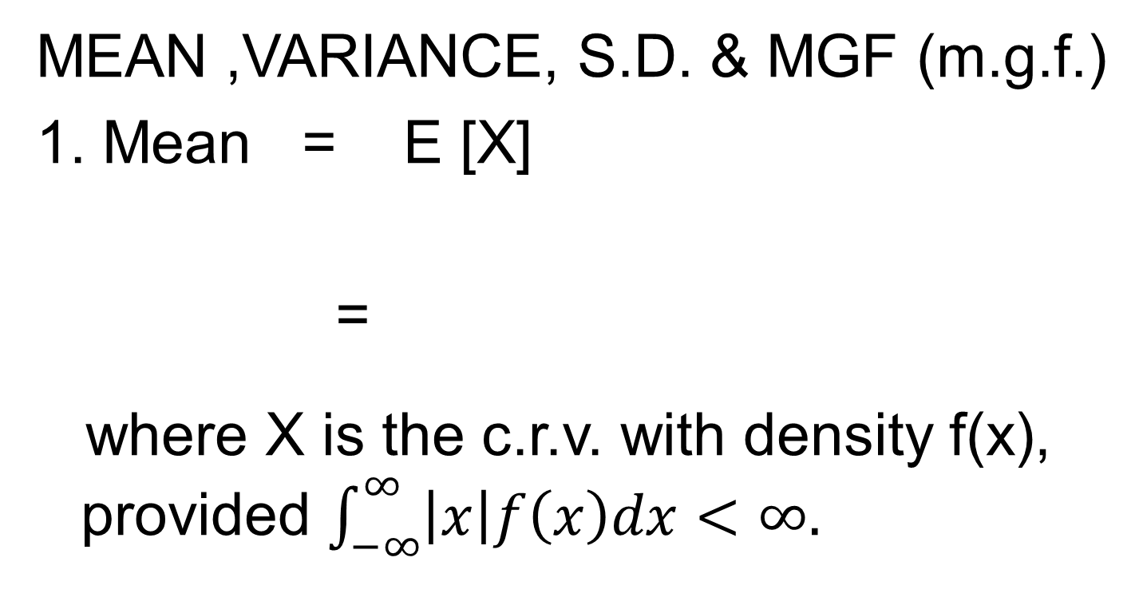
EXPECTATION & DISTRIBUTION PARAMETERS

Slide 22
2. Let X be the c.r.v. with density f(x). Let H(x) be a random variable. The expected value of H(x) is defined as:
provided
is finite.

Slide 23
…continue
3. Var X = E[X²] – (E[X])² = σ² , where
Variance is shape parameter in the sense that a random variable with small variance will have a compact density; one with a large variance will have a density that is rather spread out or flat.

Slide 24
…continue
4. m.g.f. = Moment Generating Function
= E[ e^{tX}] = m_{X} (t) =

Slide 25
Section 4.2, page 141, 17
Let X denote the length in minutes of a long distance telephone conversation. The density for X is given by
Find the moment generation function m_{X}(t).

Slide 26
Solution:
1

Slide 27
(b) Use m_{X}(t) to find the average length of such call.
Sol.
(c) Find variance and standard deviation for X.
Sol.

Slide 28
MGF of uniform distribution random variable on (a, c) :
Notes:
28

Slide 29
Use definition to find mean and variance can be found.

Slide 30
Section 4.1, page no 139, 6
If a pair of coils were placed around a homing pigeon and magnetic field was applied that reverses the earth’s field, it is thought that the bird would become disoriented. Under these circumstances it is just as likely to fly in one direction as in any other.

Slide 31
θ
Pigeon
Home (0)
is uniformly distributed over the interval [0, 2π].
a) Find the density for θ.

Slide 32
(b) Sketch the graph of the density.
(c) Shade the area corresponding to the probability that a bird will orient within π/4 radians of home, and find this area using plane geometry.
(d) Find the probability that a bird will orient within π/4 radians of home by integrating the density over the appropriate region(s).

Slide 33
(e) If 10 birds are released independently and at least 7 orient within π/4 radians of home, would you suspect that perhaps the coil are not disorienting the birds to the extent expected? Explain, based on the probability of this occurring. (Ans : 0.0035)
(f) Find mean, variance for θ.

Slide 34
Example : A random variable X with density
is said to have a Cauchy distribution with parameters a and b. This distribution is interesting in that it provides an example of a continuous random variable whose mean does not exist. Let a = 1, b = 0 to obtain a special

Slide 35
Cauchy distribution with density
Sol:

Slide 36
Multiply and divide by 2, we get
which does not exist, as

Slide 37
GAMMA DISTRIBUTION
A random variable X with density function
= 0 , for x ≤ 0,
is said to have a Gamma Distribution with parameters α and β,for α > 0,β > 0.

Slide 38
Gamma Function
Definition : The function Γ defined by
is called the Gamma function.
Properties :
Γ(1) = 1
Γ (α) = (α -1) Γ (α -1 ); where α>1 is real number.
Γ(n) = (n-1)! (Factorial of n-1), n = 1,2,3….
Γ (1/2)=√π

Slide 39
Γ(1) = 1
Proof: By definition of Gamma function, we have

Slide 40
2. Γ(α) = (α -1) Γ (α -1 ); where α is the +ve real number.
Proof:
by integrating by parts, we have

Slide 41
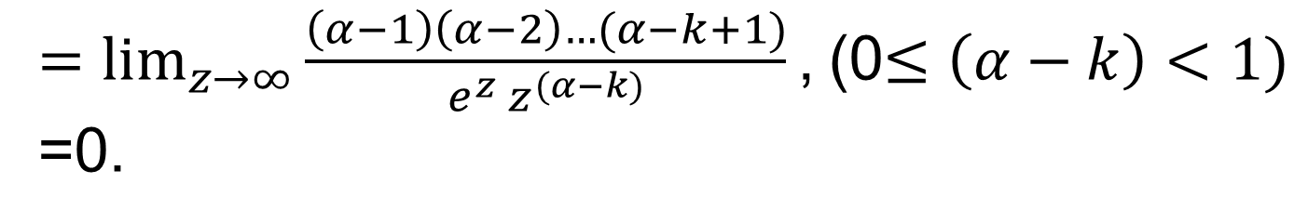
$=\lim_{z→∞}{\frac{\left(α−1\right)\left(α−2\right)…(α−k+1)}{e^{z} z^{(α−k)}}\text{,}}$(0$≤\left(α−k\right)<1)$
=0.

Slide 42
Thus,
Since,

Slide 43
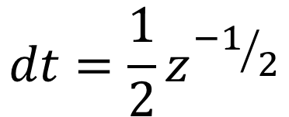

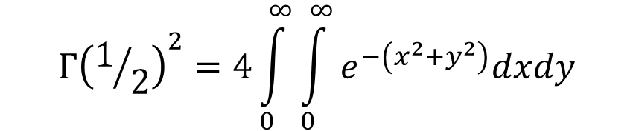


$$z=t^{2}$$
Convert to polar coordinates and see it is π.

Slide 44
GAMMA DISTRIBUTION
A random variable X with density function
is said to have a Gamma Distribution with parameters α and β,for x > 0,α > 0,β > 0.

Slide 45
To check the necessary and sufficient condition of pdf:

Slide 47
MEAN, VARIANCE AND MGF OF GAMMA FUNCTION
Let X be a Gamma r.v. with parameters α and β.
Then
1. m.g.f. = m_{X}(t)=(1- βt)^{-α} , t < 1/ β
2. E[X] = Mean = μ_{X} = α β
3. Var(X) = σ² = α β²

Slide 48
Proof:

Slide 53
α and β both play a role in determining the mean and the variance of the random variable.
Graphs of Gamma Densities are not symmetric and are located entirely to the right of the vertical axis.

Slide 54
f(x)
x

Slide 55
For α > 1, the maximum value of the density occurs at the point x = (α – 1)β.

Slide 56
f(x)
x

Slide 57
Exercise 4.3 (Page No: 143)
Let X be a gamma random variable with
α = 3 and β = 4
(i) What is the expression for the density for X

Slide 58
(ii) What is the moment generating function for X
(iii) Find mean, variance and standard deviation

Slide 59
Exponential Distribution
In Gamma Distribution, put α = 1, we get

Slide 60
f(x)

Slide 61
Cont…
For the above function
Mean = μ = β, var (X) = β²,
m_{X}(t)=(1- βt)⁻¹ , t < 1/β

Slide 62
The c.d.f. of exponential distribution with Parameter β is given by

Slide 63
The c.d.f. of exponential distribution

Slide 64
Poisson Process and Exponential dist :
Theorem 4.3.3 For a Poisson process with parameter λ, Let W be the time of the occurrence of the first event. W has an exponential distribution with parameter β = 1/λ.

Slide 65
Proof:
The distribution function F for W is given by
Here, we have that the first occurrence of the event will take place after time w only if number of occurrences in the time interval [0,w] is zero.
Let X be the number of occurrences of
the event in this time interval [0,w].

Slide 66
X is a Poisson random variable with parameter λw. Thus,

Slide 67
Since, in the continuous case, the derivative of the cumulative distribution function is the density
This is exactly density for an exponential random variable with

Slide 68
Section 4.3, page no 144,34
A particular nuclear plant releases a detectable amount of radioactive gases twice a month on average. Find the probability that at least 3 months will elapse before the release of first detectible emission. What is the average time one must wait to observe the first emission?

Slide 69
Solution :
Let X be time elapsed before the release of the first detectable emission a then X is an exponential distribution with β = ½, as the radioactive gas is released in Poisson process with λ=2.

Slide 70
Example
A computer centre maintains a telephone consulting service to trouble shoot for its users. The service is available for 9:00 to 5:00 each working day. Past experience shows number of calls received per day is a Poisson distribution with parameter 50. For a given day find the probability that first call will be received
(i) before 10:00 a.m. (ii) after 3:00 p.m.

Slide 71
Solution
For 8 hours parameter is 50. Hence for an hour parameter is λ = 50/8 = 25/4.
Hence waiting time W is exponential distribution with parameter β = 4/25
(i) P(first call will be recorded before 10:00)
= P(W ≤ 1)
= F(1) = 1 - e^{-(1)(25/4)}
= 1 - e^{-(25/4)}

Slide 72
(ii) after 3:00 p.m.
(ii) P(first call will be recorded after 3:00)
= P(W ≥ 6)
= 1- F(6) = 1 - (1 - e^{-(6)(25/4)})
= e^{-(150/4)}

Slide 73
GAMMA RANDOM VARIABLE
A random variable X with density function
is said to have a Gamma Distribution with parameters α and β,for x > 0, α > 0, β > 0.

Slide 74
Chi-square distribution
If a random variable X has a gamma distribution with parameters β = 2 and α = γ/2, γ is a positive integer, then X is said to have a chi-square (χ²) distribution with γ degrees of Freedom and denoted by .

Slide 75
β = 2 and α = γ/2,
E[ ] = γ, Var[ ] = 2 γ

Slide 76
Chi square distribution
f(x)
x

Slide 77
Chi square distribution

Slide 78
Chi square distribution
f(x)
x

Slide 79
for γ = 10
f(x)
x

Slide 80
We do not have explicit formula for CDF F of X² _{γ}. Instead values are tabulated on page no. 695-696 as below (F occurs in margin here, and related value of r.v. inside the table):

Slide 81
P[X² _{γ}< t]
γ F
0.100
0.250
0.500
5
1.61
2.67
4.35
6
2.20
3.45
5.35
7
2.83
4.25
6.35
If F is CDF for Chi square random variable
Having 5 degrees of freedom
F(1.61) = 0.1, F(4.35) = 0.5

Slide 82
Another notation
For 0 < α < 1, we denote by , for a chi-square r.v. with γ degrees of freedom, a unique number such that
P[X²_{γ} ≥ ] = α
Probability to the right of is α.
for exampleP[X²₁₀ ≥ ] = 0.05

Slide 83
Probability to the right of is α.
f(x)
0.05
P[X²₁₀ ≥ ] = 0.05
x
= 1 - P[X²₁₀ ≥ ] = 0.95

Slide 84
P[X² _{γ} ≤ t]
γ F
0.90
0.95
0.975
10
16.0
18.3
20.5
11
17.3
19.7
21.9
12
18.5
21.0
23.3

Slide 85
Probability to the right of is r.
f(x)
0.05
x
P[X²₁₀ ≥ ] = 0.05

Slide 86
38. Consider a chi – squared random variable with 15 degrees of freedom.
(i) What is the mean of
Sol: Chi square distribution is Gamma with α = γ/2 & β = 2, Mean = αβ = γ =15 and σ² = αβ² = 30

Slide 87
(ii) What is the expression for the density for
Sol:

Slide 88
(iii) What is the expression for the moment Generating function for
Sol:

Slide 89
(iv) Find
P[X² _{γ}< t]
γ F
0.005
0.010
.025
0.900
15
4.60
5.23
6.26
22.3
16
5.14
5.81
23.5
6.91
17
5.70
6.41
24.8
7.56

Slide 90
P[X² _{γ}< t]
γ F
0.005
0.010
.025
0.900
15
4.60
5.23
6.26
22.3
16
5.14
5.81
6.91
23.5
17
5.70
6.41
24.8
7.56

Slide 91
(vi) Find χ²_{0.05, &} χ²_{0.01} for 15 degree of freedom
Sol. P[X²₁₅ > χ²_{r}] = r.
P[X² _{γ}< t]
γ F
0.005
0.010
.025
0.950
15
4.60
5.23
6.26
25.0
P[X²₁₅ > χ²_{0.05}] = 0.05.
P[X²₁₅ ≤ χ²_{0.05}] = 0.95.

Slide 92
P[X² _{γ}< t]
γ F
0.005
0.010
.025
0.990
15
4.60
5.23
6.26
30.6
P[X²₁₅ > χ²_{r}] = r.
P[X²₁₅ > χ²_{0.01}] = 0.01.
P[X²₁₅ ≤ χ²_{0.01}] = 0.99.

